Slide 1
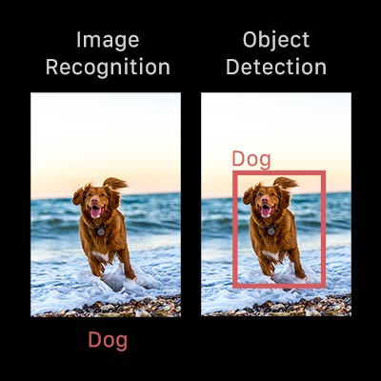

Slide 2
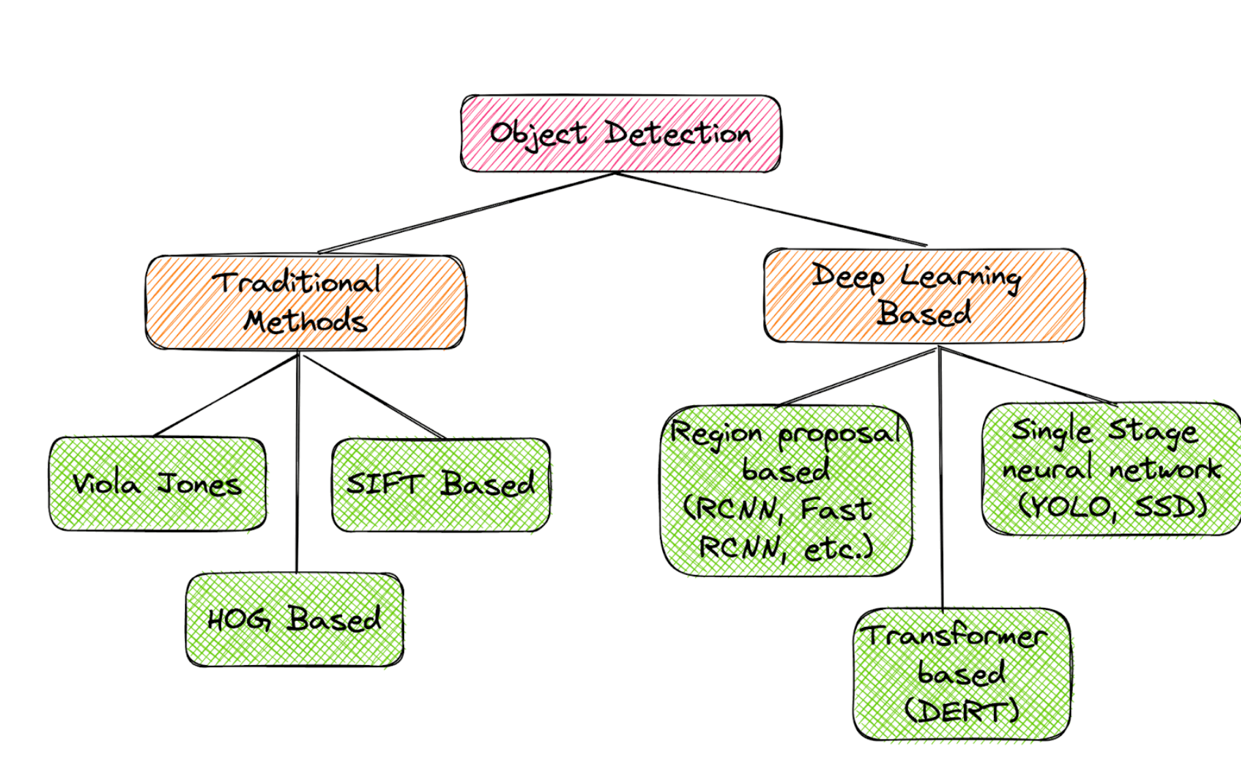

Slide 3
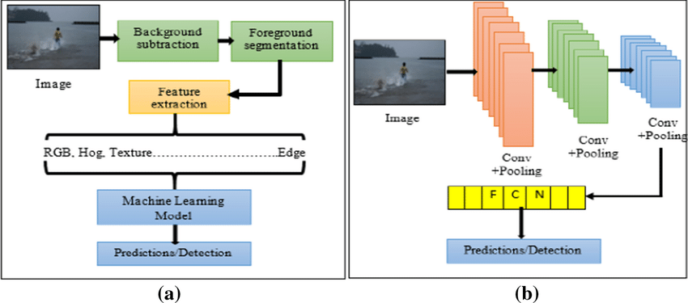
Object Detection: Non-Neural Methods
They uses machine learning model for object detection. It uses a cascade of classifiers, along with selecting different image features
Viola-Jones object detection method based on Haar features
Scale-Invariant Feature Transform (SIFT)
Histogram of Oriented Gradients (HOG).

Slide 4
Object detection Methods
R-CNN, Fast R-CNN, Faster R-CNN, and YOLO
Classification of Object Detection Algorithms
Object detection algorithms can be broadly classified into two categories: single-shot detectors and two-shot(or multi-shot) detectors. These two types of algorithms have different approaches to the task of object detection.
Single-Shot Object Detection
Single-shot detectors (SSDs) are a type of object detection algorithm that predict the bounding box and the class of the object in one single shot. This means that in a single forward pass of the network, the presence of an object and the bounding box are predicted simultaneously. This makes SSDs very fast and efficient, suitable for tasks that require real-time detection.
Structure of SSD
Examples of single-shot object detection algorithms include YOLO (You Only Look Once) and SSD (Single Shot MultiBox Detector). YOLO divides the input image into a grid and for each grid cell, predicts a certain number of bounding boxes and class probabilities. SSD, on the other hand, predicts bounding boxes and class probabilities at multiple scales in different feature maps.

Slide 5
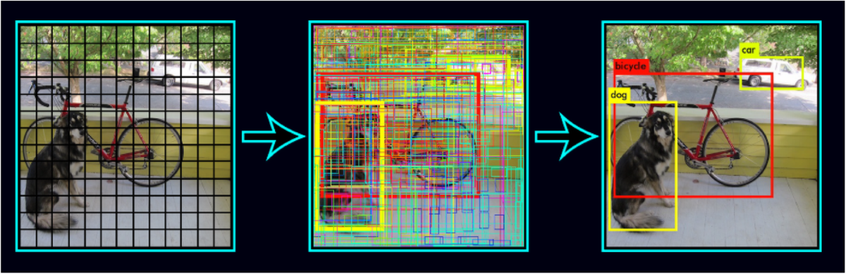

Slide 6
Two-Shot Object Detection
Two-shot or multi-shot object detection algorithms, on the other hand, use a two-step process for detecting objects. The first step involves proposing a series of bounding boxes that could potentially contain an object. This is often done using a method called region proposal. The second step involves running these proposed regions through a convolutional neural network to classify the object classes within the box.
Examples of two-shot object detection algorithms include R-CNN (Regions with CNN features), Fast R-CNN, and Faster R-CNN. These algorithms use region proposal networks (RPNs) to propose potential bounding boxes and then use CNNs to classify the proposed regions.

Slide 7
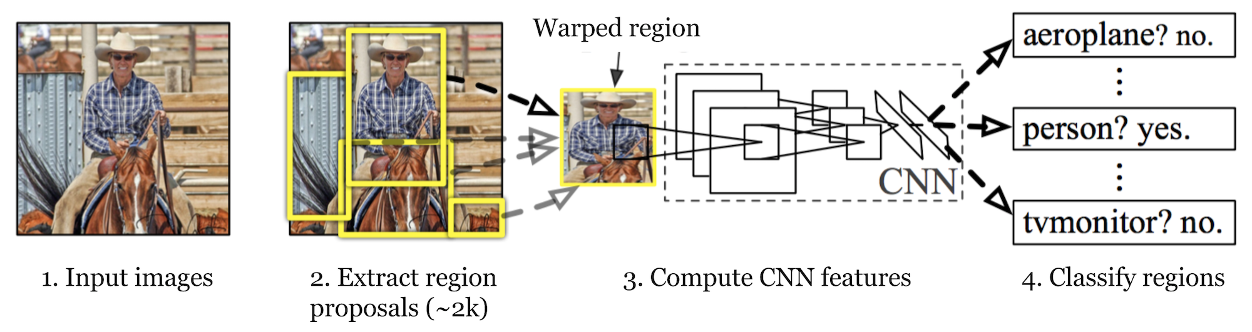
Object Detection: Neural Methods
Region-Based Convolutional Neural Networks (R-CNN)
Region-Based CNN uses convolutional neural networks to classify image regions in order to detect objects. It involves training a CNN on a large labeled dataset and then using the trained network to detect objects in new images. Region-Based CNN and its successors, Fast R-CNN and Faster R-CNN, are known for their accuracy but can be computationally intensive.

Slide 8
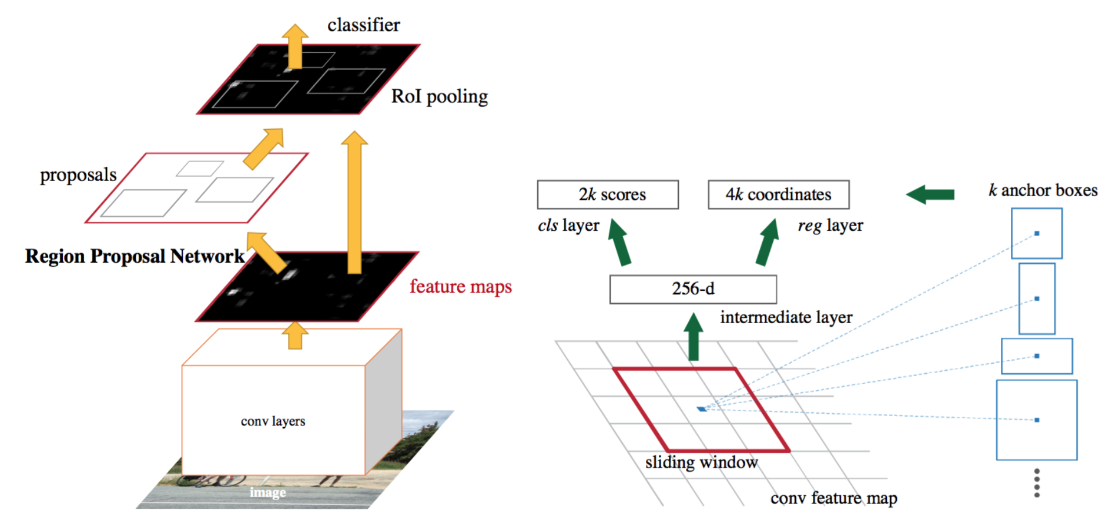
Object Detection: Neural Methods
Faster R-CNN
Faster R-CNN is an advanced version of R-CNN that introduces a Region Proposal Network (RPN) for generating region proposals. The RPN shares full-image convolutional features with the detection network, thus enabling nearly cost-free region proposals. The RPN is a fully convolutional network that simultaneously predicts object bounds and objectness scores at each position. Faster R-CNN is faster than the original R-CNN and Fast R-CNN because it doesn’t need to run a separate region proposal method on the image, which can be slow.

Slide 9
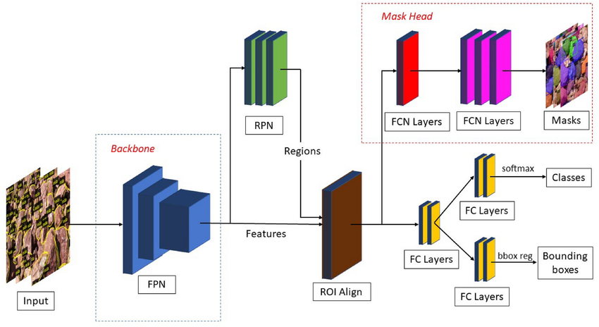
Object Detection: Neural Methods
Mask R-CNN
Mask R-CNN extends Faster R-CNN by adding a branch for predicting an object mask in parallel with the existing branch for bounding box recognition. This allows Mask R-CNN to generate precise segmentation masks for each detected object, in addition to the class label and bounding box. The mask branch is a small fully convolutional network applied to each RoI, predicting a binary mask for each RoI. Mask R-CNN is simple to train and adds only a small computational overhead, enabling a fast system and rapid experimentation.

Slide 10
Object Detection: Neural Methods
Single Shot Detector (SSD)
SSD is a method for object detection that eliminates the need for multiple network passes for multiple scales. It discretizes the output space of bounding boxes into a set of default boxes over different aspect ratios and scales per feature map location. SSD is faster than methods like R-CNN because it eliminates bounding box proposals and pooling layers.
RetinaNet
RetinaNet uses a feature pyramid network on top of a backbone to detect objects at different scales and aspect ratios. It introduces a new loss, the Focal Loss, to deal with the foreground-background class imbalance problem. RetinaNet is designed to handle dense and small objects.
EfficientDet
EfficientDet is a method that scales all dimensions of the network width, depth, and resolution with a compound scaling method to achieve better performance. It introduces a new architecture, called BiFPN, which allows easy and efficient multi-scale feature fusion, and a new scaling method that uniformly scales the resolution, depth, and width for all backbone, feature network, and box/class prediction networks at the same time. EfficientDet achieves state-of-the-art accuracy with fewer parameters and less computation compared to previous detectors.

Slide 11
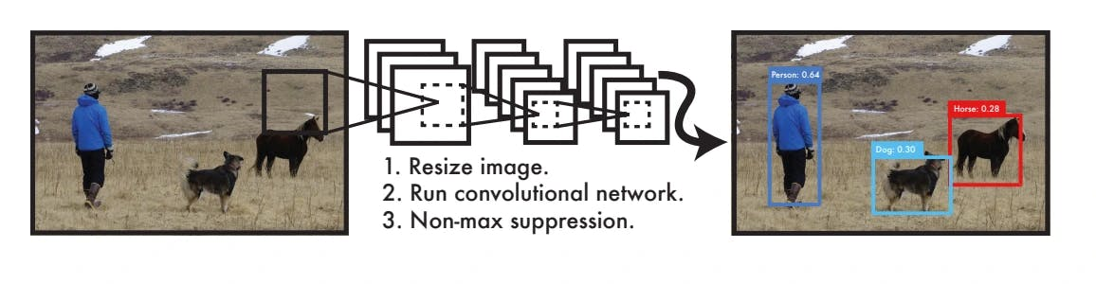
You Only Look Once (YOLO)
YOLO, developed by Joseph Redmon et al., frames object detection as a regression problem to spatially separated bounding boxes and associated class probabilities. It looks at the whole image at test time so its predictions are informed by global context in the image. YOLO is known for its speed, making it suitable for real-time applications.

Slide 12
YOLO Object Detection Algorithm: How Does it Work? YOLO Architecture
The YOLO algorithm employs a single Convolutional Neural Network (CNN) that divides the image into a grid. Each cell in the grid predicts a certain number of bounding boxes. Along with each bounding box, the cell also predicts a class probability, which indicates the likelihood of a specific object being present in the box.
Bounding Box Recognition Process
The bounding box recognition process in YOLO involves the following steps:
Grid Creation: The image is divided into an SxS grid. Each grid cell is responsible for predicting an object if the object’s center falls within it.
Bounding Box Prediction: Each grid cell predicts B bounding boxes and confidence scores for those boxes. The confidence score reflects how certain the model is that a box contains an object and how accurate it thinks the box is.
Class Probability Prediction: Each grid cell also predicts C conditional class probabilities (one per class for the potential objects). These probabilities are conditioned on there being an object in the box.

Slide 13
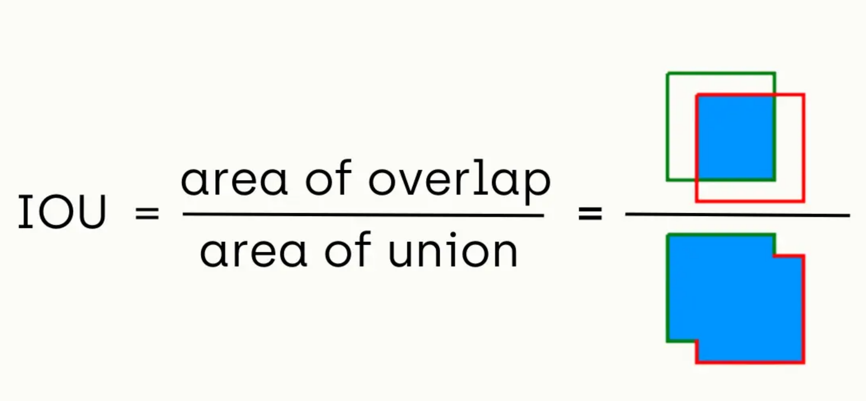
Object Detection: Performance Evaluation Metrics
IoU (Intersection over Union) Calculation
Intersection over Union (IoU) is a common metric used to evaluate the performance of an object detection algorithm. It measures the overlap between the predicted bounding box (P) and the ground truth bounding box (G). The IoU is calculated as the area of intersection divided by the area of union of P and G.
The IoU score ranges from 0 to 1, where 0 indicates no overlap and 1 indicates a perfect match. A higher IoU score indicates a more accurate object detection.

Slide 14
Average Precision (AP)
Average Precision (AP) is another important metric used in object detection. It summarizes the precision-recall curve that is created by varying the detection threshold.
Precision is the proportion of true positive detections among all positive detections,
while recall is the proportion of true positive detections among all actual positives in the image.
The AP computes the average precision values for recall levels over 0 to 1. The AP score ranges from 0 to 1, where a higher value indicates better performance.
The mean Average Precision (mAP) is often used in practice, which calculates the AP for each class and then takes the average.

Slide 15
Non-Max Suppression (NMS)
After the bounding boxes and class probabilities are predicted, post-processing steps are applied. One such step is Non-Max Suppression (NMS). NMS helps in reducing the number of overlapping bounding boxes. It works by eliminating bounding boxes that have a high overlap with the box that has the highest confidence score.
Vector Generalization
Vector generalization is a technique used in the YOLO algorithm to handle the high dimensionality of the output. The output of the YOLO algorithm is a tensor that contains the bounding box coordinates, objectness score, and class probabilities.
This high-dimensional tensor is flattened into a vector to make it easier to process. The vector is then passed through a softmax function to convert the class scores into probabilities. The final output is a vector that contains the bounding box coordinates, objectness score, and class probabilities for each grid cell.

Slide 16
Vector Generalization
Vector generalization is a technique used in the YOLO algorithm to handle the high dimensionality of the output. The output of the YOLO algorithm is a tensor that contains the bounding box coordinates, objectness score, and class probabilities.
This high-dimensional tensor is flattened into a vector to make it easier to process. The vector is then passed through a softmax function to convert the class scores into probabilities. The final output is a vector that contains the bounding box coordinates, objectness score, and class probabilities for each grid cell.
volution of YOLO: YOLOv1, YOLOv2, YOLOv3, YOLOv4, YOLOR, YOLOX, YOLOv5, YOLOv6, YOLOv7, YOLOv8, YOLOv9

Slide 17
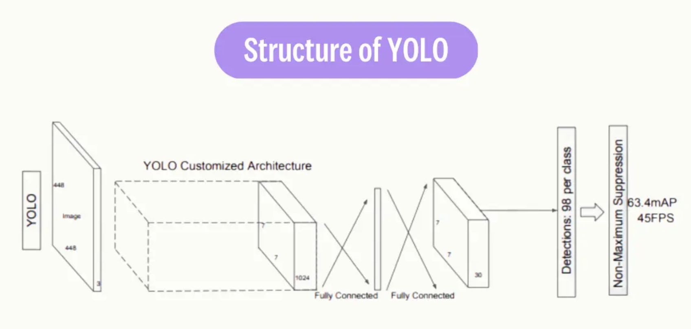

Slide 18
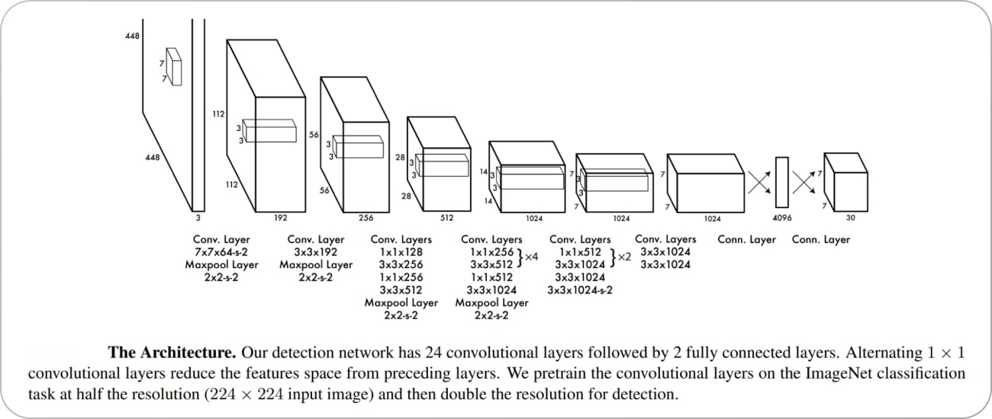
YOLO Object Detection Algorithm: How Does it Work? YOLO Architecture
The YOLO algorithm employs a single Convolutional Neural Network (CNN) that divides the image into a grid. Each cell in the grid predicts a certain number of bounding boxes. Along with each bounding box, the cell also predicts a class probability, which indicates the likelihood of a specific object being present in the box.

Slide 19
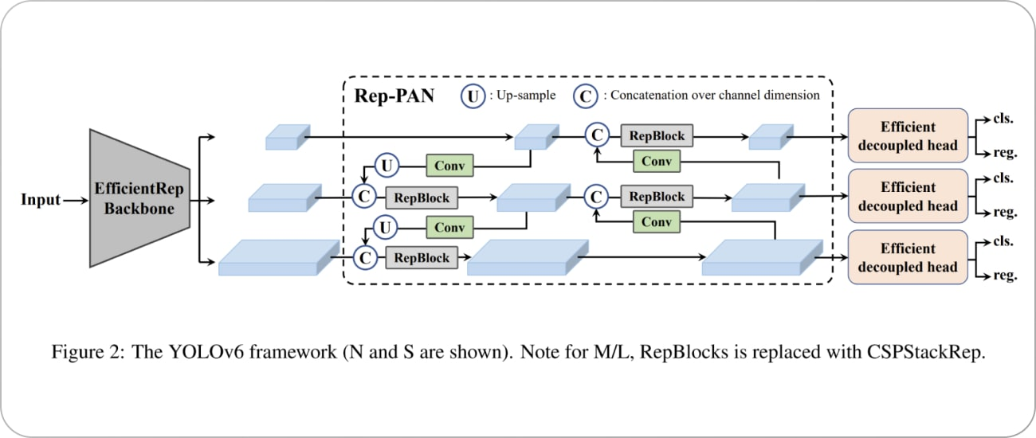

Slide 22
Object Detection: Neural Methods
Region-Based Convolutional Neural Networks (R-CNN)
Region-Based CNN uses convolutional neural networks to classify image regions in order to detect objects. It involves training a CNN on a large labeled dataset and then using the trained network to detect objects in new images. Region-Based CNN and its successors, Fast R-CNN and Faster R-CNN, are known for their accuracy but can be computationally intensive.
Faster R-CNN
Faster R-CNN is an advanced version of R-CNN that introduces a Region Proposal Network (RPN) for generating region proposals. The RPN shares full-image convolutional features with the detection network, thus enabling nearly cost-free region proposals. The RPN is a fully convolutional network that simultaneously predicts object bounds and objectness scores at each position. Faster R-CNN is faster than the original R-CNN and Fast R-CNN because it doesn’t need to run a separate region proposal method on the image, which can be slow.
Mask R-CNN
Mask R-CNN extends Faster R-CNN by adding a branch for predicting an object mask in parallel with the existing branch for bounding box recognition. This allows Mask R-CNN to generate precise segmentation masks for each detected object, in addition to the class label and bounding box. The mask branch is a small fully convolutional network applied to each RoI, predicting a binary mask for each RoI. Mask R-CNN is simple to train and adds only a small computational overhead, enabling a fast system and rapid experimentation.

